Slide 1
CHAP II. INSTRUCTION SET ARCHITECTURE AND DESIGN
2.1 Memory Locations and Operations:
At the beginning of each instruction cycle, the processor fetches an instruction from memory. The program counter (PC) holds the address of the instruction to be fetched next, the processor always increments the PC after each instruction fetch so that it will fetch the next instruction in sequence.
The information stored and/or retrieved from the memory needs to be addressed. A program consists of a number of instructions that have to be accessed in a certain order.
Instruction is a binary coded command designed for a specific task such as: Arithmetic and logic instructions, Looping and decision making, Transfer of data and Transfer of code.
The instruction Specifies two things: opcode: operation to be performed and operands: data/locations to be used for operation

Slide 2
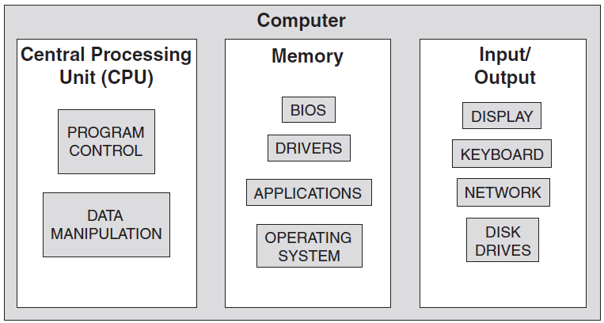
Control: An instruction may specify that the sequence of execution be altered. Control unit interprets instruction and generates sequence of control signals to carry out.
On this figure, we see three main elements are the control and data processor, the input and output, or I/O devices, and the program
that is executing on the machine.
In general, these actions fall into three categories:
Processor-memory: Data may be transferred from processor to memory or from memory to processor.
• Processor-I/O: Data may be transferred to or from a peripheral device by transferring between the processor and an I/O module.
• Data processing: The processor may perform some arithmetic or logic operation on data.
•

Slide 3
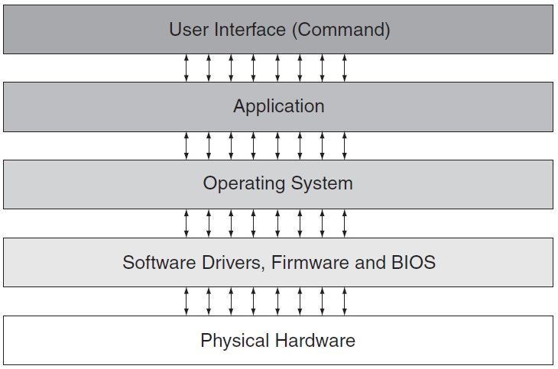
This diagram shows the flow of information, rather than the flow of control.
.
This type of architecture is named John Von Neumann architecture after the mathematician who conceived the design
Computer
Data
CPU
Main Memory
Bus
Control

Slide 4
The busses connect the various functional block of the
computer both internally and externally and are grouping of similar signals with processor eg 32-bit address.
On computer memory is the place where program code (instructions) and variables (data) are stored.
Computer uses electronic circuit that switches on and off very quickly, through the binary numbers system or Binary code (0,1 digits in Base 2), Binary, octal and hexadecimal are the natural number bases of computers to convert between them and decimal.
Octal code (0,1,2,3,4,5,6,7 digits in Base 8)
Decimal code (0,1,2,3,4,5,6,7,8,9 in Base 10) and Hexadecimal code (0,1,2,3,4,5,6,7,8,9,A,B,C,D,E,F digits in Base 16).
Every typed character is occupying a space on memory (registers).

Slide 5
Today we already have computers that can manipulate
64-bit numbers in one operation. It is likely to play fast action video games on your PC through the video card that has a video processing computer chip on it that can process 128 bits at a time.
The processor has a 32-bit data bus and a 32-bit address
bus.
A very large number of registers may increase the clock cycle time simply because it takes electronic signals longer when they must travel farther.

Slide 6
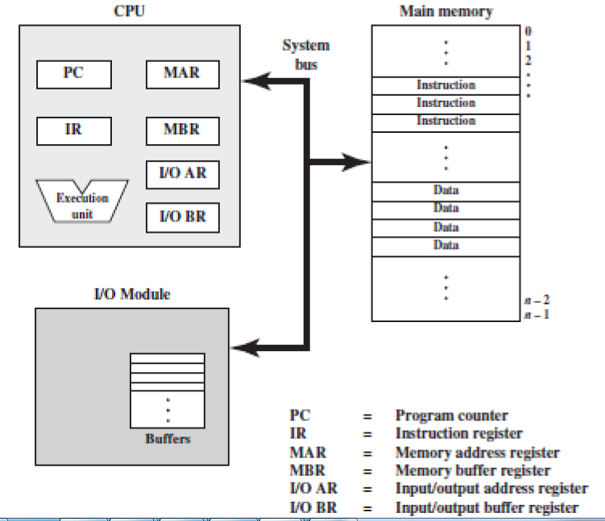
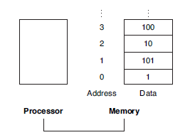
Interactions among computer components

Slide 7
The CPU exchanges data with memory by usage of two internal registers: a memory address register (MAR), which specifies the address in memory for the next read or write, and a memory buffer register (MBR), which contains the data to be written into memory or receives the data read from memory.
I/O address register (I/OAR) specifies a particular I/O device. An I/O buffer (I/OBR) register is used for the exchange of data between an I/O module and the CPU.
A memory module consists of a set of locations, defined by sequentially numbered addresses.
Each location contains a binary number that can be interpreted as either an instruction or data. An I/O module transfers data from external devices to CPU and memory, and vice versa. It contains internal buffers for temporarily holding these data until they can be sent on.

Slide 8
Three basic steps are needed in order for the CPU to perform a write operation into a specified memory location:
1. The word to be stored into the memory location is first loaded by the CPU into a specified register, called the memory data register (MDR).
2. The address of the location into which the word is to be stored is loaded by the CPU into a specified register, called the memory address register (MAR).
3. A signal, called write, is issued by the CPU indicating that the word stored in the MDR is to be stored in the memory location whose address in loaded in the MAR.

Slide 9
2.2. ADDRESSING MODES
Information involved in any operation performed by the CPU needs to be addressed.
In computer terminology, such information is called the operand. Therefore, any instruction issued by the processor must carry at least two types of information.
Operation performed encoded in op-code field and address information of the operand encoded in address field.
Because instructions are made by:
* Arithmetic such as add and subtract
* Logic instructions such as and, or, and not
* Data instructions such as move, input, output, load, and store
* Control flow instructions such as goto, if ... goto, call, and return.
These instructions are carried as signal using Address Decoder made by more 32-bit registers.

Slide 10
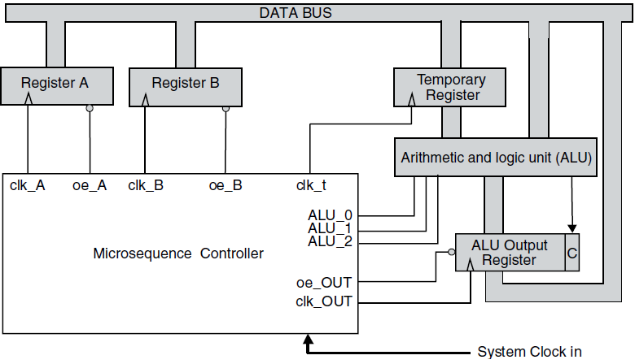
This is control system of a computing machine, so that to place data into Register A, B, C we would first have to enable another source of the data new memory, and put the data onto the Data Bus.

Slide 11
Therefore it happens an Execution Cycle
Instruction
Fetch
Obtain instruction from program storage
Instruction
Decode
Determine required actions and instruction size
Operand
Fetch
Locate and obtain operand data
Execute
Compute result value or status
Result
Store
Deposit results in storage for later use
Next
Instruction
Determine successor instruction

Slide 12
Step1. Fetch the instruction from main memory
The CPU then fetches the instruction from main memory via the data bus into the Registers.
Step2. Decode the instruction
The instruction decoder interprets and implements the instruction. The instruction register (IR) holds the current instruction, while the program counter (PC) holds the address in memory of the next instruction to be executed.
Step3. Fetch data from main memory
Fetch required data from main memory to be processed and place it into data registers.
Step4. Execute the instruction
From the instruction register, the data forming the instruction is decoded by the control unit. It then passes the decoded information to the Arithmetic logic unit (ALU) to add them together and writing the result back to a register.
Step5. Store results
The result generated by the operation is stored in the main memory, or sent to an output device.

Slide 13
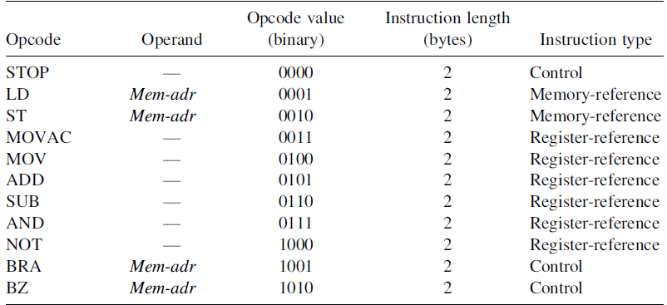
The Opcode Table for the Assembly of our Simple Processor

Slide 14
STAGES OF INSTRUCTION CYCLE:
Instruction address calculation – this is a stage where by the address of the next instruction is determined so that to be loaded into the instruction register(IR) for execution.
Its archived by adding a fixed number to the previous instruction address.
Instruction fetch – this is the action by which the instruction is fetched/loaded to the IR from the memory location.
Instruction operation decoding – analyze the instruction to determine the type of operation to be performed and operands to be used.
Operand address calculation – if the operation involves the reference to an operand in memory or i/o then determines its address.
Operand fetch- fetch the operand from memory or i/o.
Data operation – performs the operation indicated in the instruction.
Operand store- write the result into the memory or i/o.

Slide 15
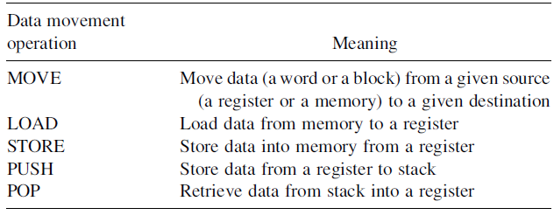
2.3. INSTRUCTION TYPES
2.3.1. Data Movement Instructions
Data movement instructions are used to move data among the different units of the machine (registers in the CPU).
Common Data Movement Operations
These instructions are for moving, loading, storing and retrieving the content of register R one to register R two, without changing the contents of the (source) .

Slide 16
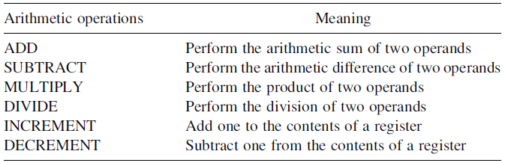
2.3.2. Arithmetic and Logical Instructions
Arithmetic and logical instructions are those used to perform arithmetic and logical manipulation of registers and memory contents.
Common Arithmetic Operations table

Slide 17
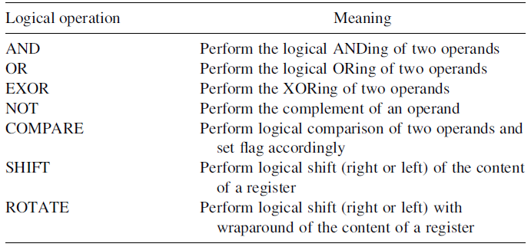
2.3.3. Sequencing Instructions
Control (sequencing) instructions are used to change the sequence in which instructions are executed.
Common Logical Operations table

Slide 18
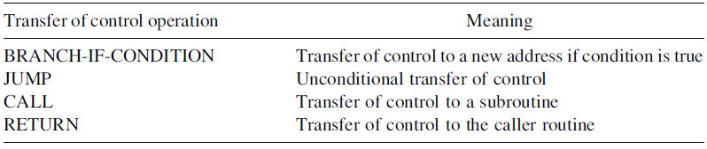
2.3.4. Input/Output Instructions
Input and output instructions (I/O instructions) are used to transfer data between the computer and peripheral devices.
Some Transfer of Control Operations table

Slide 19
Instructions complete or exceptions
A complete instruction consists of : operation code
  addressing mode
Once the computer has been started (bootstrapped) it continually executes instructions (until the computer is stopped)
Different instructions take different amounts of time to execute (typically)
All instructions and data are contained in main memory
Exceptions, or errors, may occur at various points in the instruction cycle, for example:
  Addressing - the memory does not exist or is inaccessible
  Operation - the operation code does not denote a valid operation
  Execution - the instruction logic fails, typically due to the input data
    divide by zero
    integer addition/subtraction overflow etc

